Slide 1





Lessons Learned after 10 Million Diagnostics
Chris Zhu | CTO & Cofounder @ Primary.Health
© Primary 2022- All Rights Reserved.
Notes:
Not an academic. Share learnings, experience, rather than give recommendations for this community

Slide 2
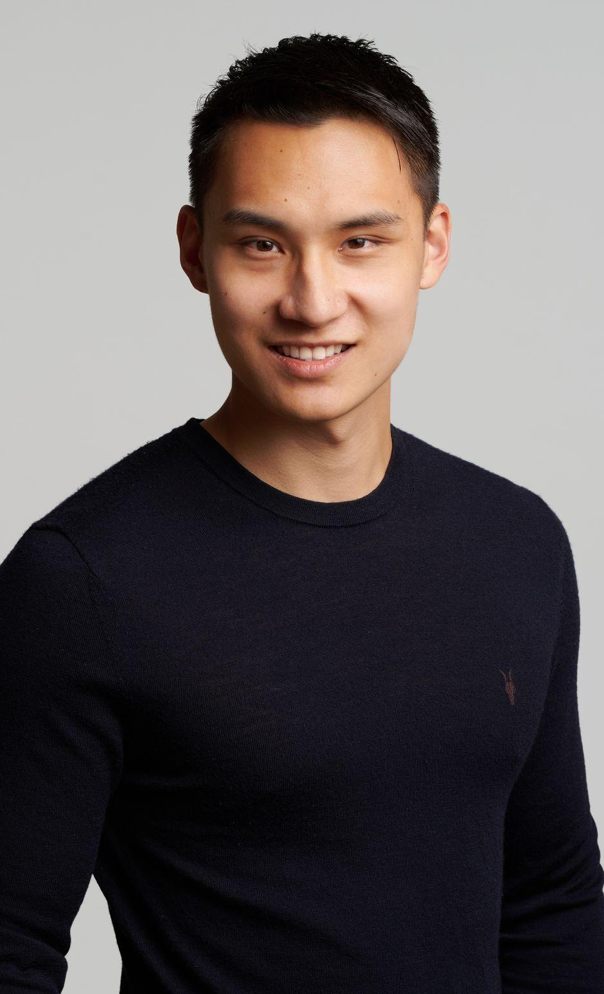



Introduction
Chris Zhu
CTO & Cofounder, Primary.Health
Background in software. Worked on machine learning at Airbnb, Instagram before starting Primary.Health.

Slide 3
Primary.Health:
At a Glance

Slide 4

Primary.Health Platform
Primary.health is a diagnostic and lab agnostic software platform to manage population health.

Slide 5
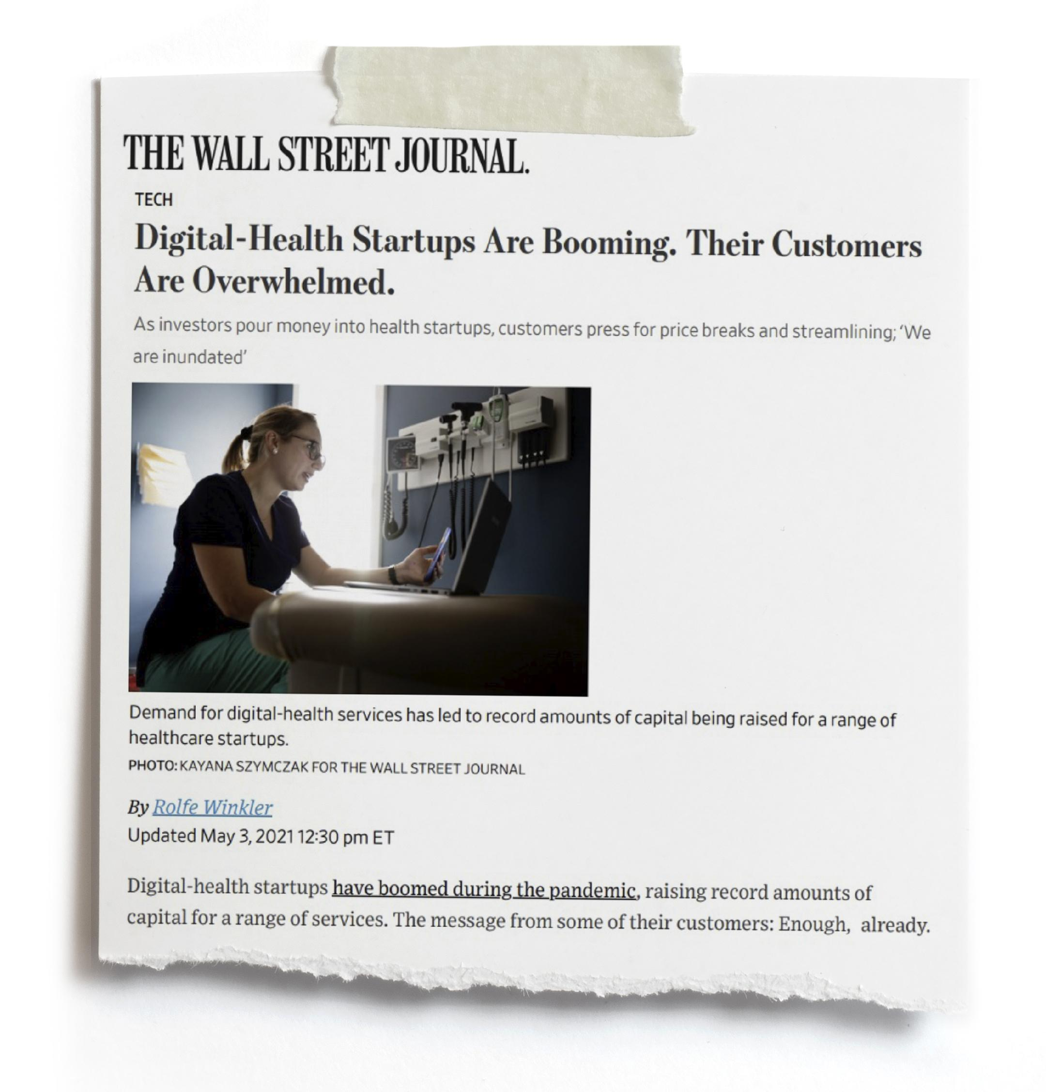

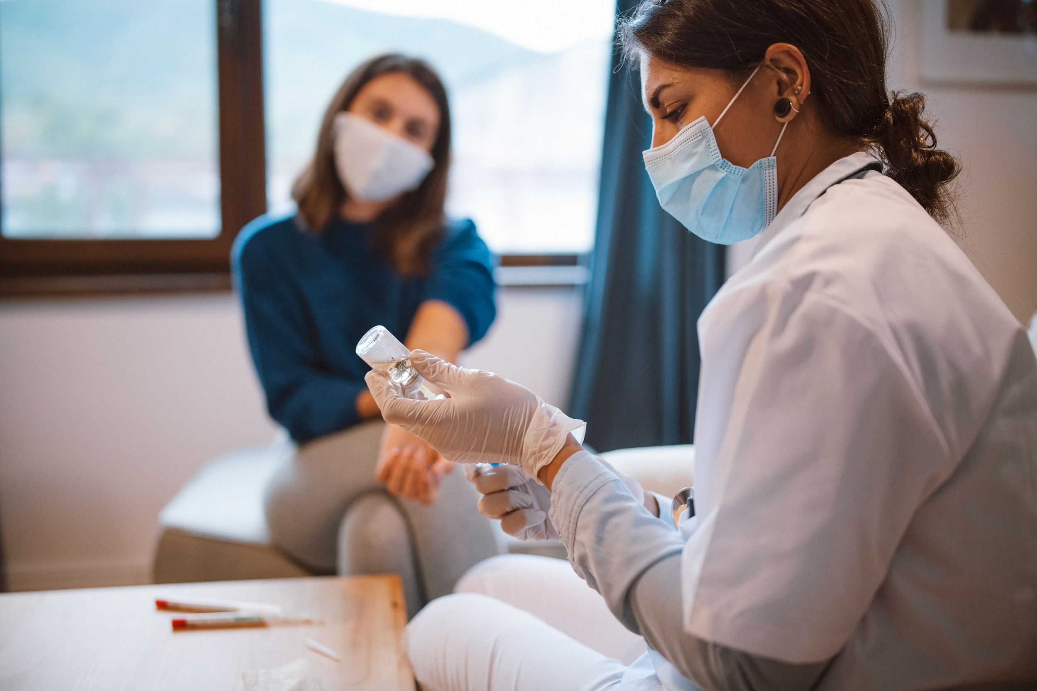



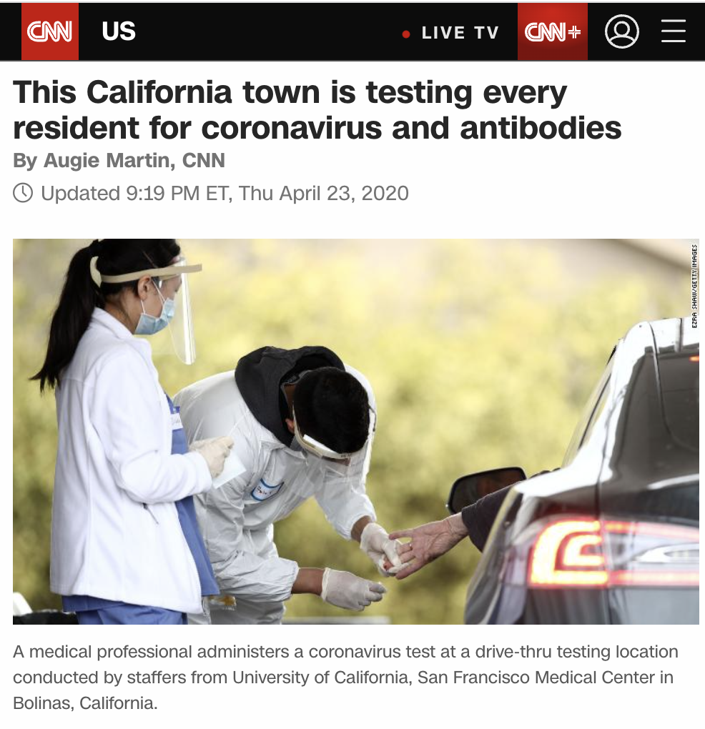



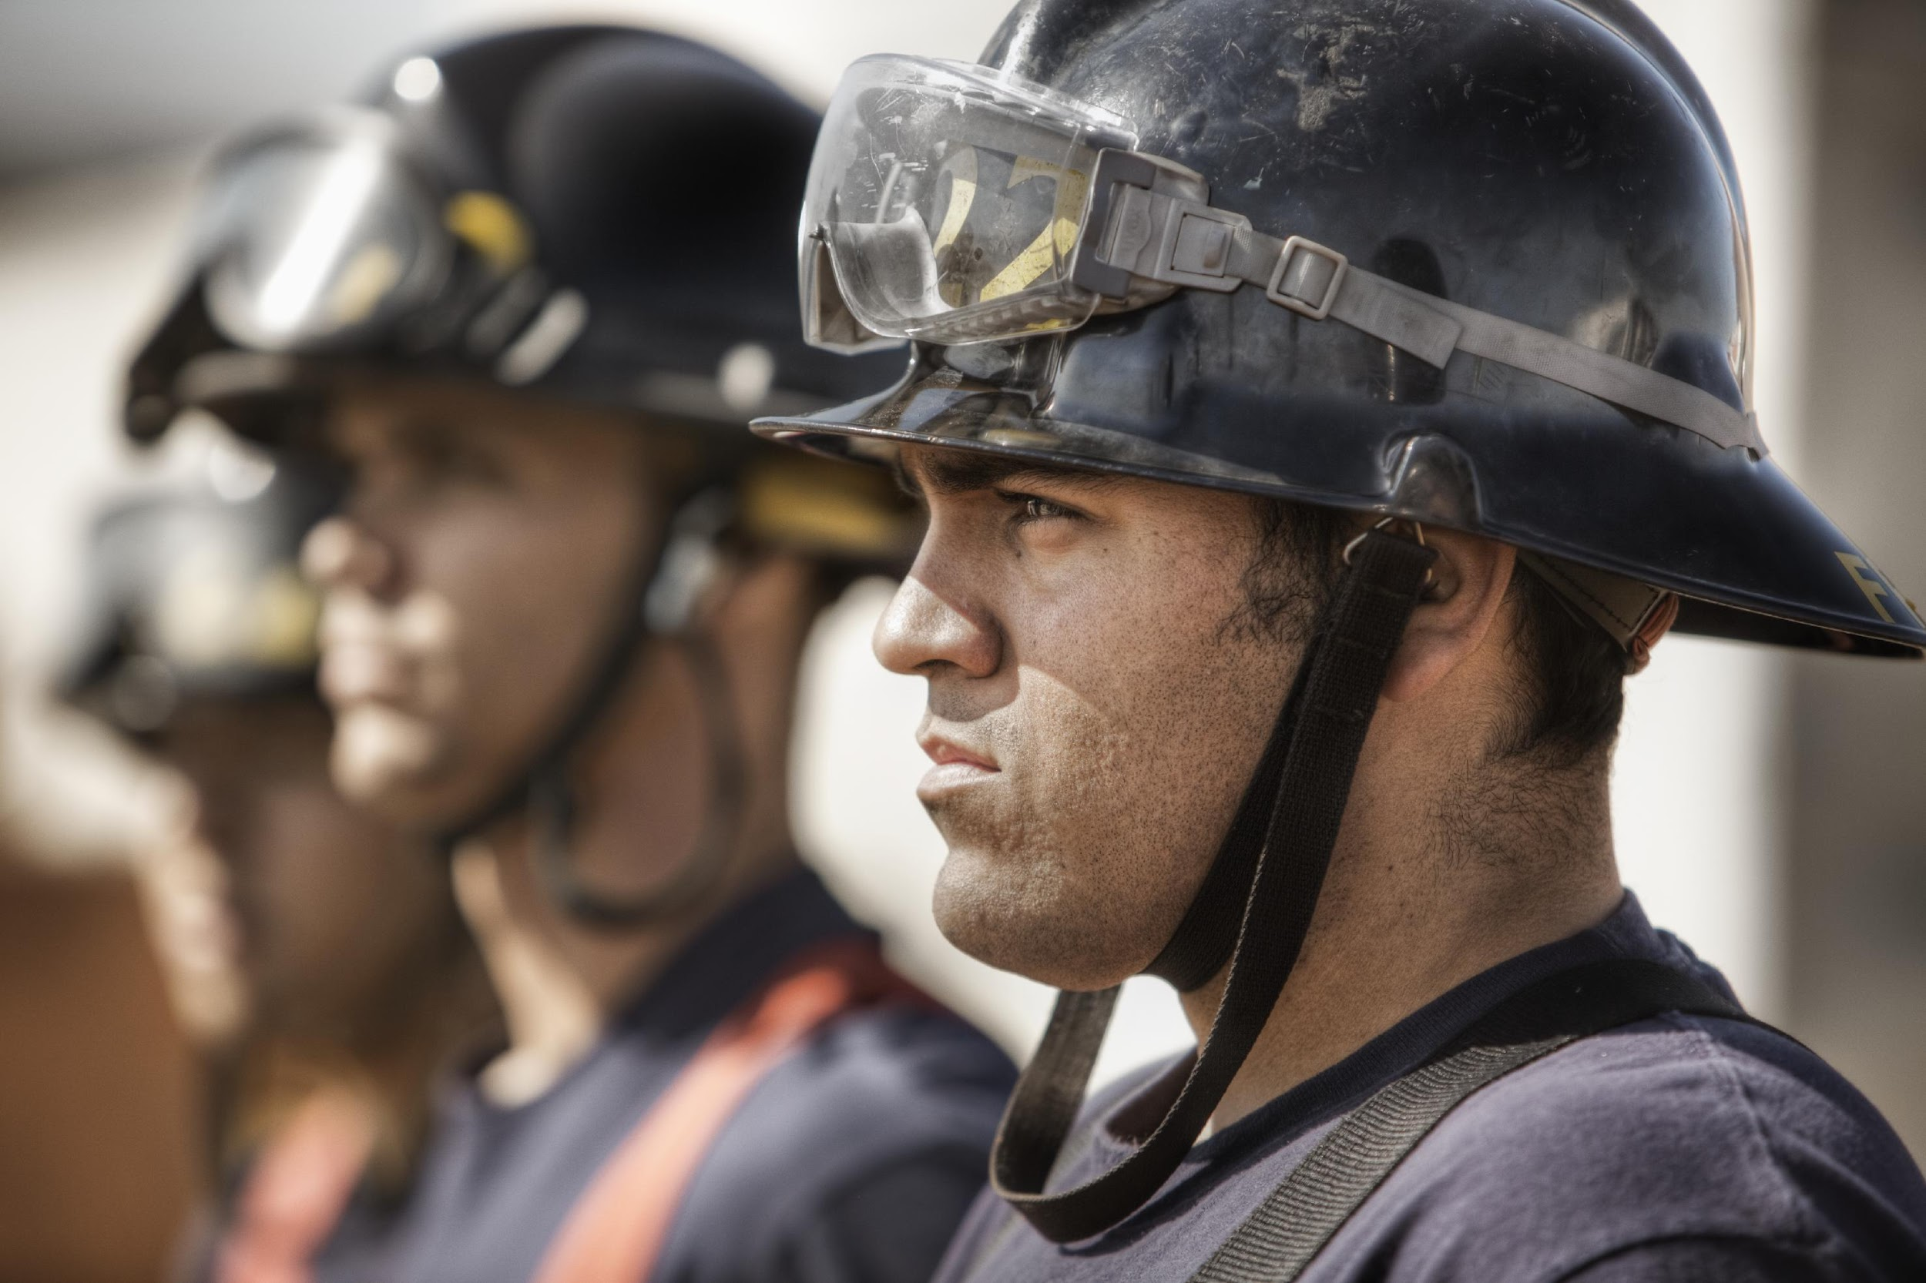






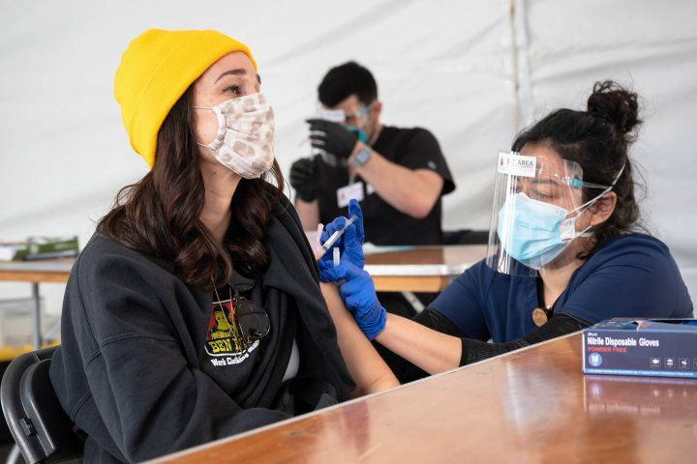
Statewide COVID-19
Response
This California town is testing every resident for COVID-19 and antibodies
By Augie Martin, CNN
SFO Airport Partners with Primary.Health to Implement COVID-19 Testing
Purdue Partners With Colorado Company to Offer Rapid Testing for Students Ahead of Spring 2021 Semester
COVID Vaccines Offered At Hayward Fire Station
Expands into:
Long-term care
Homeless shelters
Employers
Airports
Events
When UC San Francisco researchers and their community partners in the Unidos en Salud coll
13M+ Tests & vaccines administered
Bolinas, CA
May 2020
Aug 2022
Studies:
UCSF & UofL
Partners with:
Launches in
15+ states
New care models
Pilots into:
Well-child school programs
OTC testing
Multiplex/Dog study
Community clinics (HIV, diabetes, hypertension, flu)
Air monitoring
New at-home diagnostics
UCSF Partnership brings COVID-19 Testing to Mission District
By Augie Martin, CNN

Slide 6




Fast forward to today
>10K+
locations
1.5M+
vaccines
12M+
diagnostics
6M+
lives
across all programs
across the US
doses administered
tests administered
Notes:
1.5 M vaccines (covid, flu, monkeypox, polio)
12M diagnostics (40 lab integrations + 15 antigen tests)

Slide 7













































































Organizations we serve

Slide 8
Case Study
Enabling diagnostic
stewardship outside the clinic

Slide 9
Working with California Department of Public Health to keep schools open and safe with low-cost diagnostics

Slide 10

Scale
>8K+
schools
5.5M+
of COVID-19
2.5M+
lives
in California
in California
tests administered

Slide 11

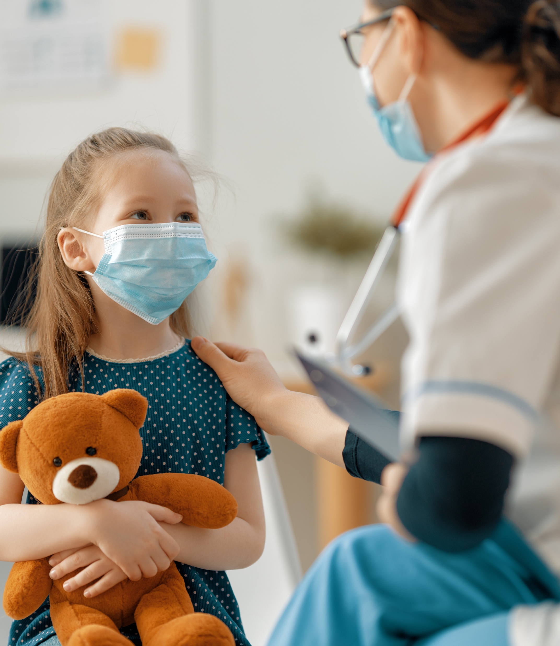





School based COVID-19 Testing Program
Receive kits through school
Enrollment
Messaging
At home / in school test resulting
Actionable reporting

Slide 12
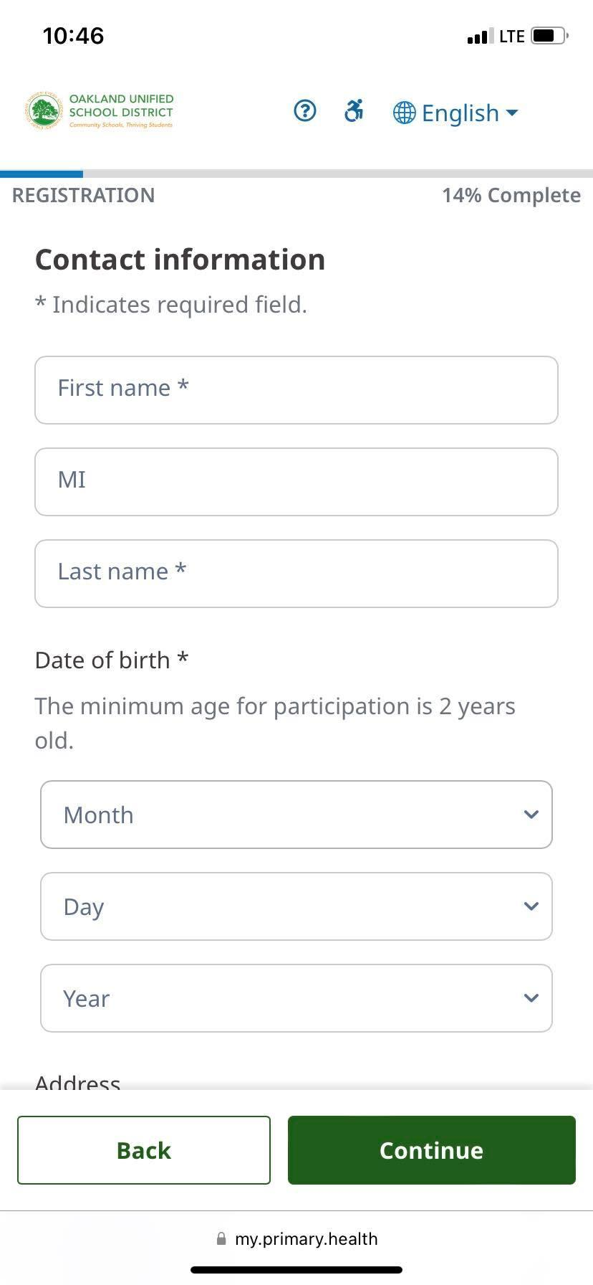
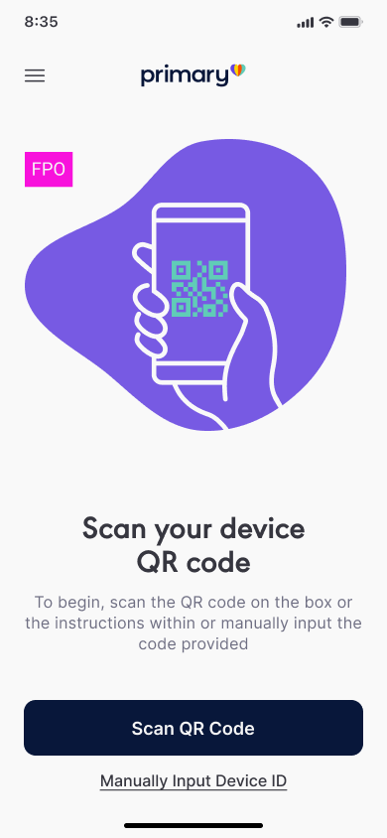
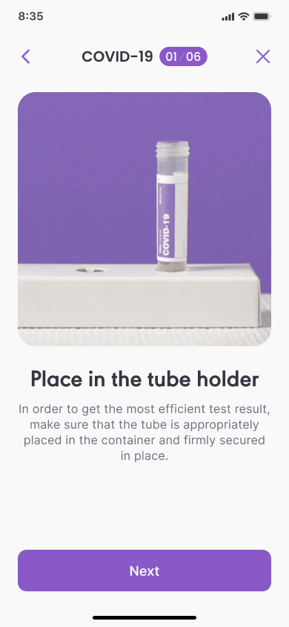
How do you use it?
Simple Instructions for at-home consumer administration
Works on desktop, tablet, web, etc
Super simple instructions
Consumer designed packaging

Slide 13
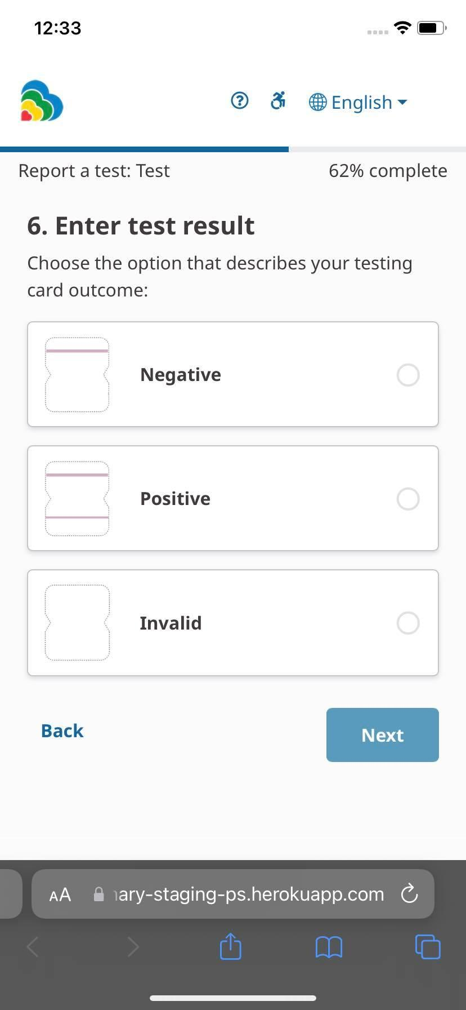
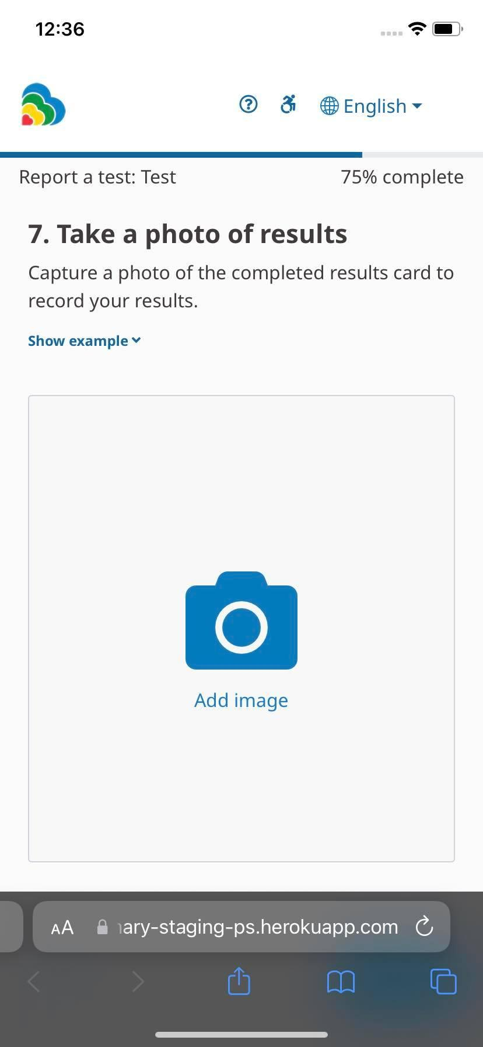
Collecting results
Self reporting

Slide 14
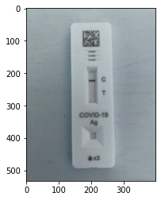
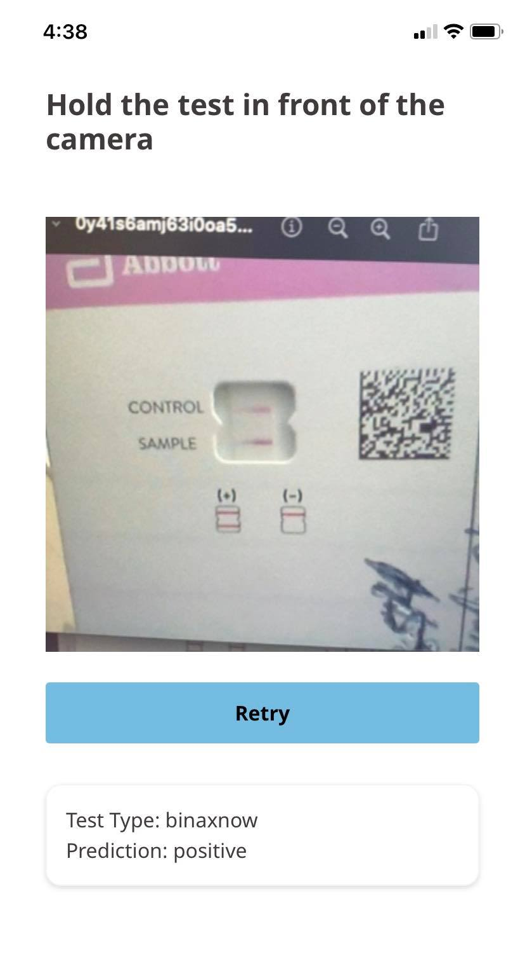
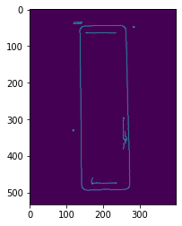
Is it accurate?
99.8% accuracy
0.5% user errors
0.2% are model errors
Running in production on ~ 50k tests / wk
Neural network based approach

Slide 15
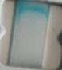

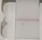

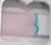

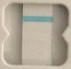

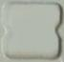
Some interesting examples
Missing reagent
Manufacturing issues
Result read too early

Slide 16
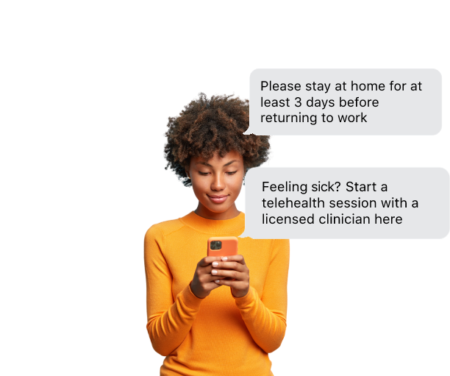
Treatment & follow-up
Result delivery
Quarantine
Public health reporting
Positive case follow up
Test to treat - expedited access to telehealth
and Rx’s upon positive test
EHR integrations
Notes:
Need a text message example

Slide 17

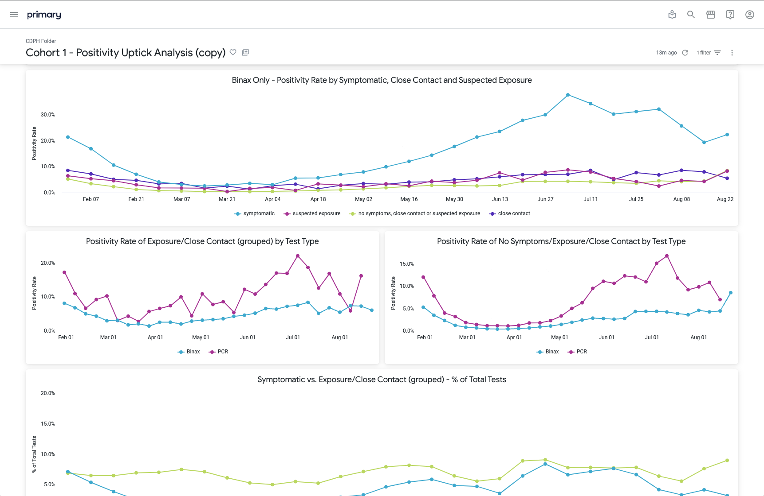
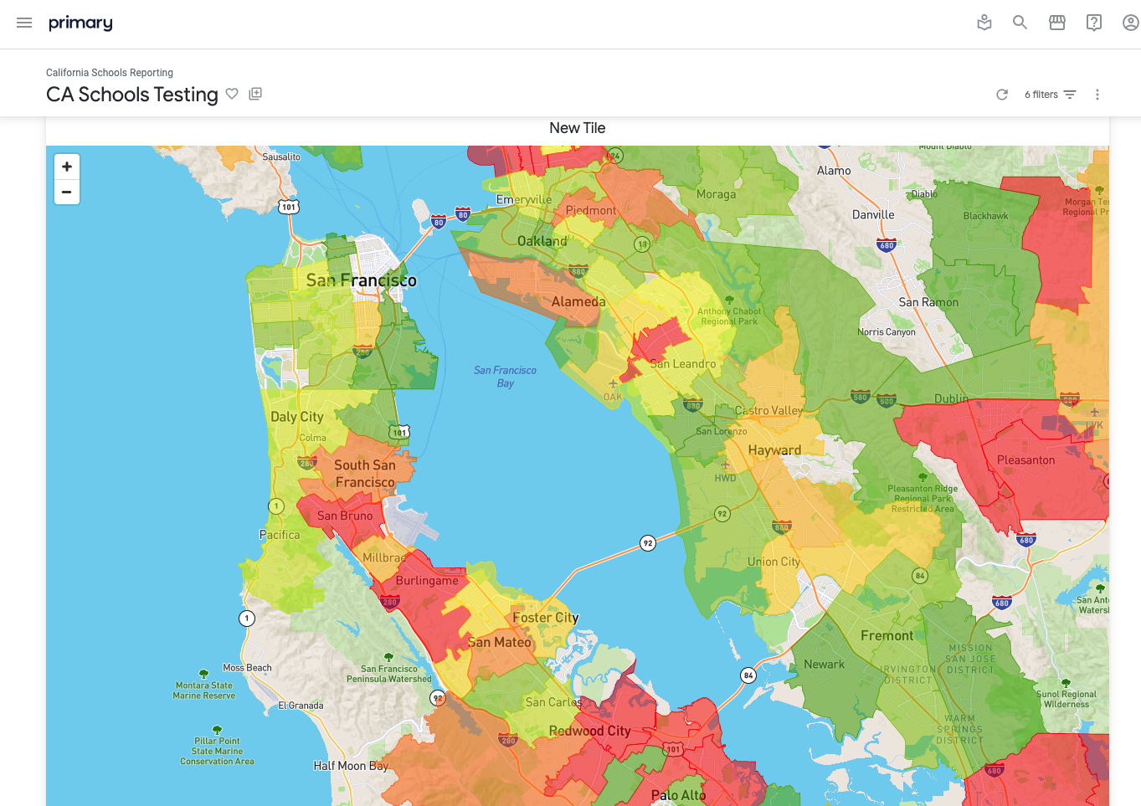
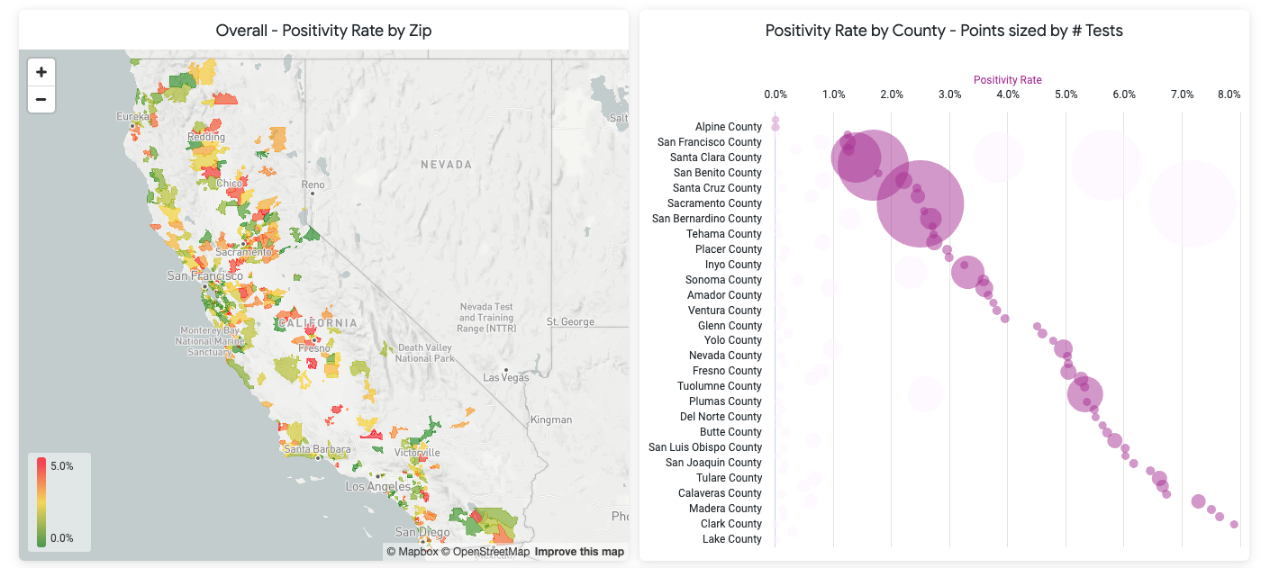
Administrative backend
Analytics Enable program compliance, quality analysis and public health reporting, and investigation
Statistics & Analysis

Slide 18
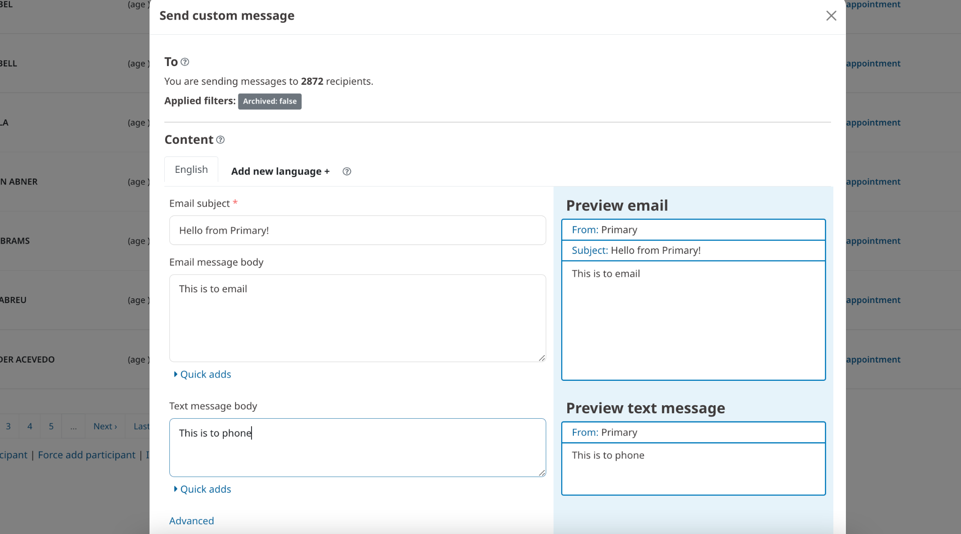
Administrative backend
Sending Messages

Slide 19
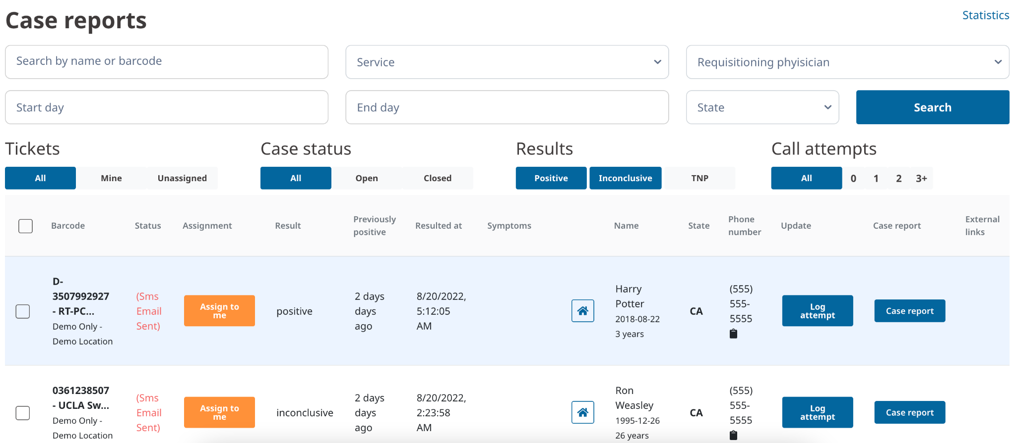
Administrative backend
Positive Case Follow Up

Slide 20
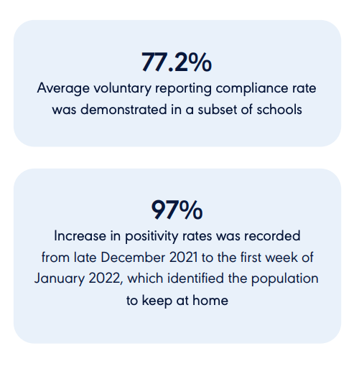
Results
Notes:
Need a text message example

Slide 21
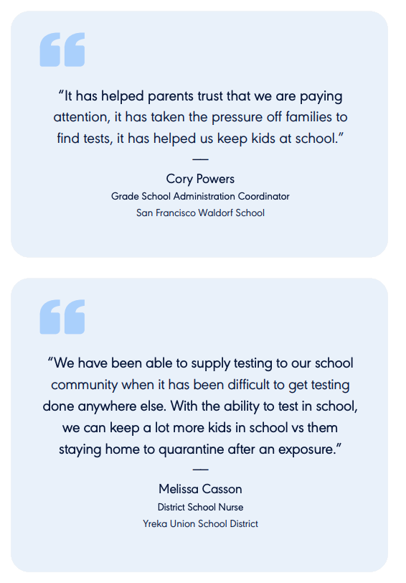
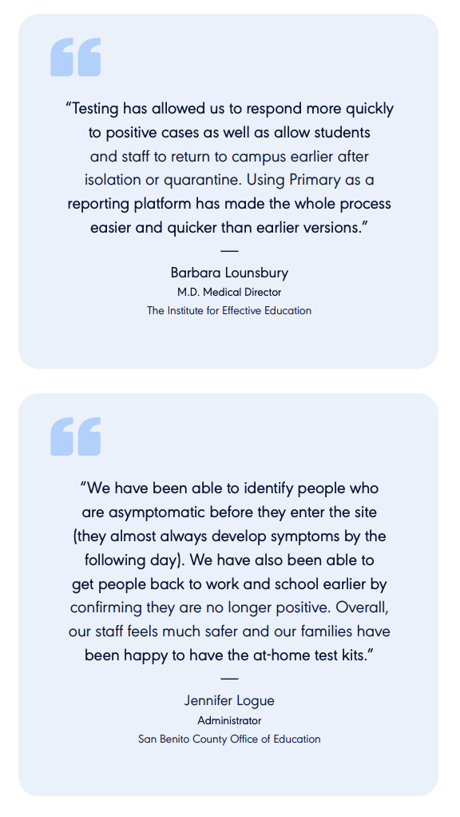
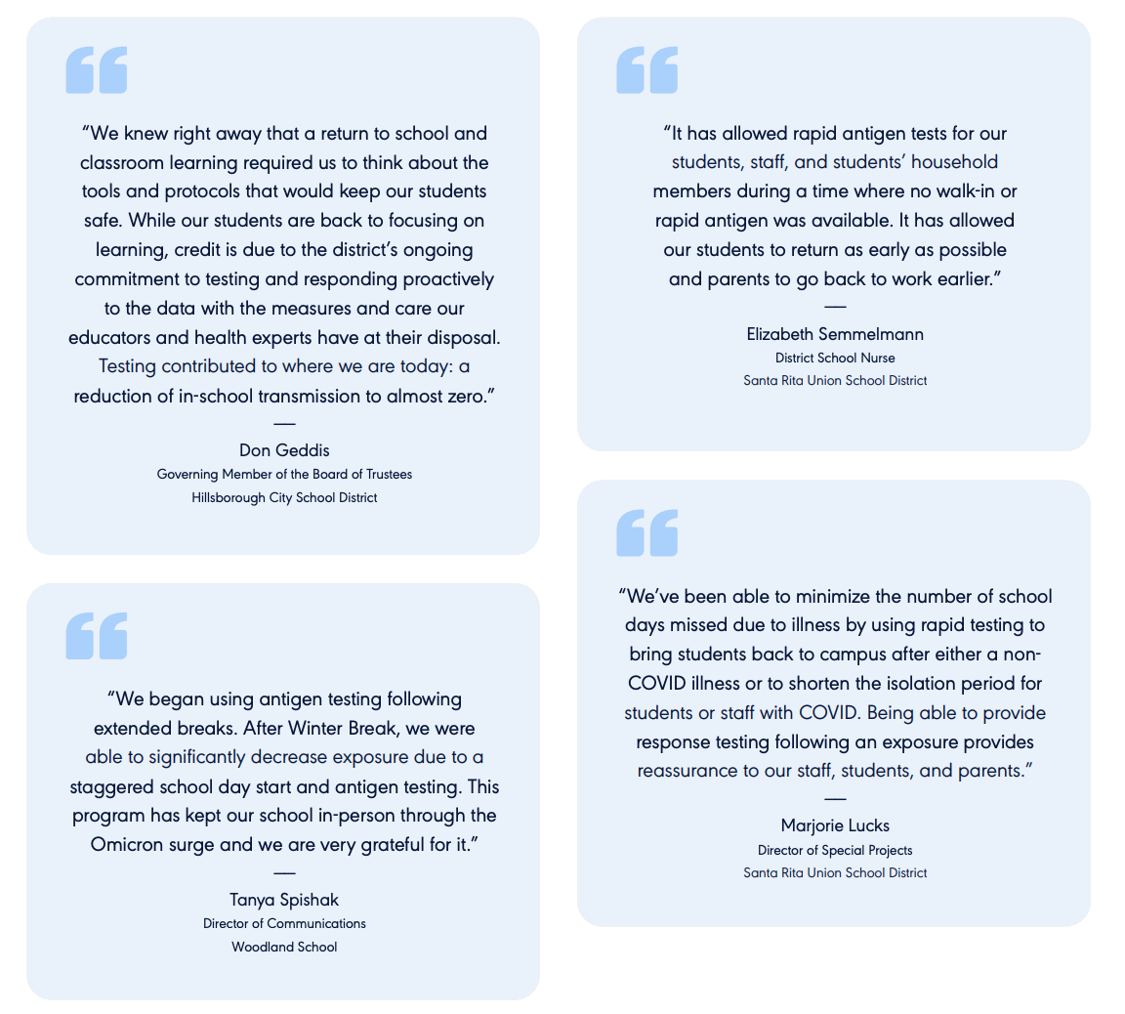
Communities we serve
Notes:
Need a text message example

Slide 22

Enable rapid testing to confirm viral vs bacterial infection
Enable home testing with OTC
Enable a whole new generation of rapid testing outside of the clinic to confirm the type of infection prior to prescription
Opportunities for diagnostic
stewardship

Slide 23
Next Steps: Accelerating the diagnostics revolution

Slide 24
We believe making diagnostics more available and integrated will improve treatments and patient outcomes.

Slide 25
We are opening our platform to all diagnostic makers.

Slide 26










What can we help with?
Identify
Who is the patient?
Demographics
Consent
ID/Insurance
Teach
How do you use this device?
How-tos
Video Proctor
Record
What are the results?
CV algorithm
React
What comes next?
MD Consult
e-Prescribe
Report
HL7™
FHIR™
SMART™
Who needs to know?
Public Health
Notes:
Attribution: Person icons created by Freepik - Flaticon
<a href="https://www.flaticon.com/free-icons/signature" title="signature icons">Signature icons created by IconBaandar - Flaticon</a>
<a href="https://www.flaticon.com/free-icons/instructions" title="instructions icons">Instructions icons created by Vitaly Gorbachev - Flaticon</a>
<a href="https://www.flaticon.com/free-icons/customer-support" title="customer support icons">Customer support icons created by amonrat rungreangfangsai - Flaticon</a>
<a href="https://www.flaticon.com/free-icons/machine-learning" title="machine learning icons">Machine learning icons created by Parzival’ 1997 - Flaticon</a>
<a href="https://www.flaticon.com/free-icons/doctor" title="doctor icons">Doctor icons created by LAFS - Flaticon</a>
<a href="https://www.flaticon.com/free-icons/prescription" title="prescription icons">Prescription icons created by TravisAvery - Flaticon</a>
<a href="https://www.flaticon.com/free-icons/report" title="report icons">Report icons created by Freepik - Flaticon</a>

Slide 27
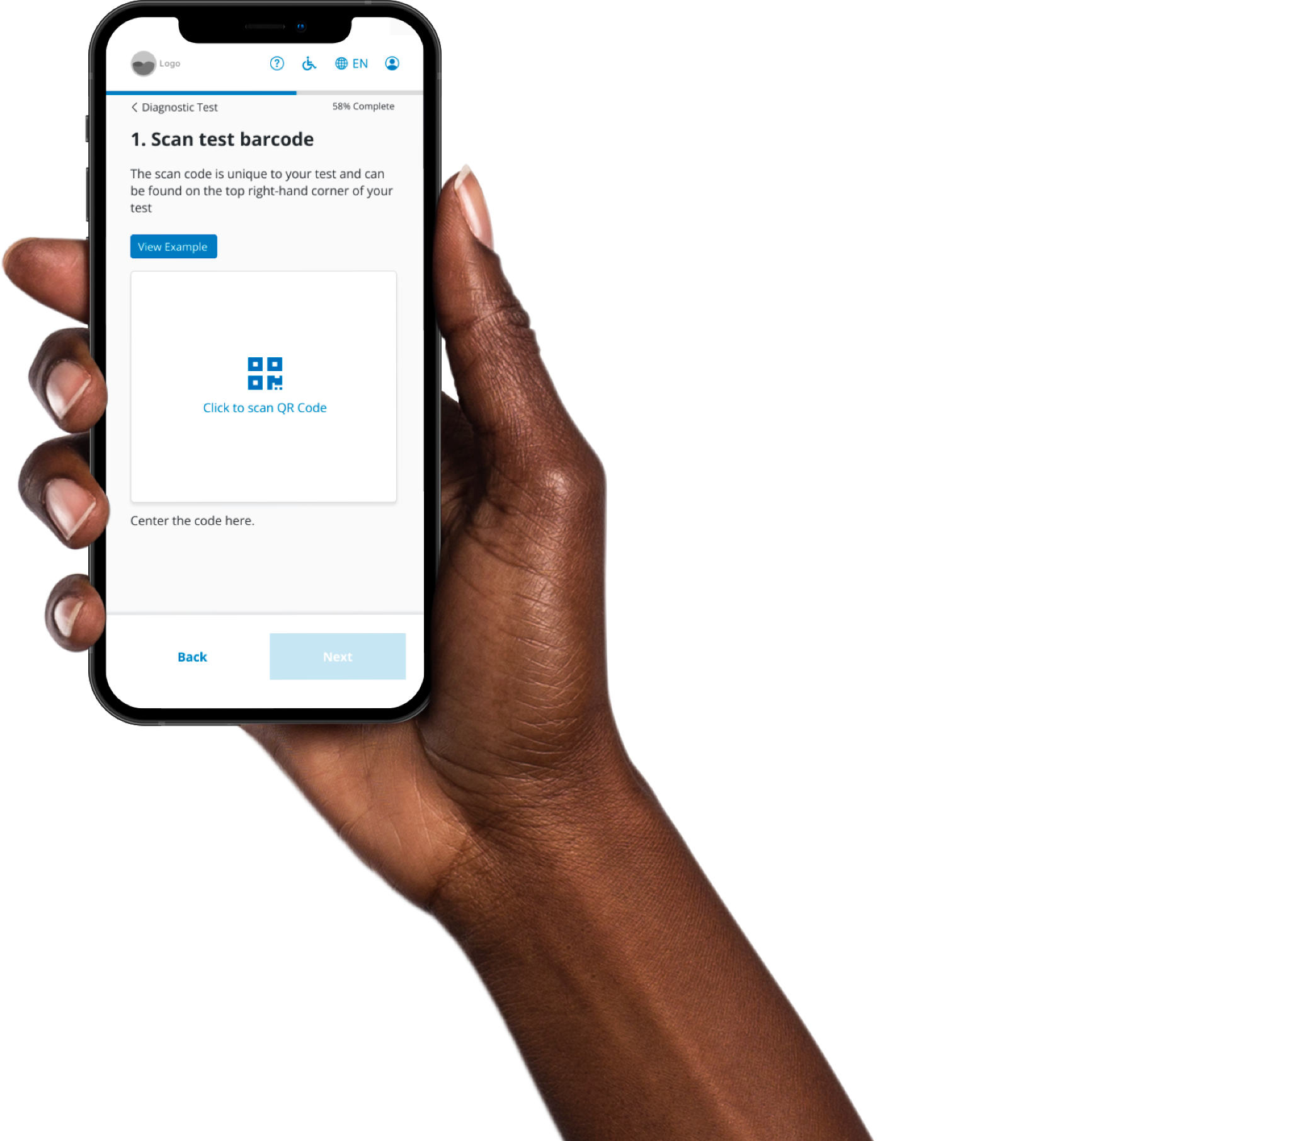
A mobile results workflow for any diagnostic
An app that works across web, iOS and Android
Custom device experiences to fit your brand
Easy walkthroughs, video tutorials, or live proctors

Slide 28
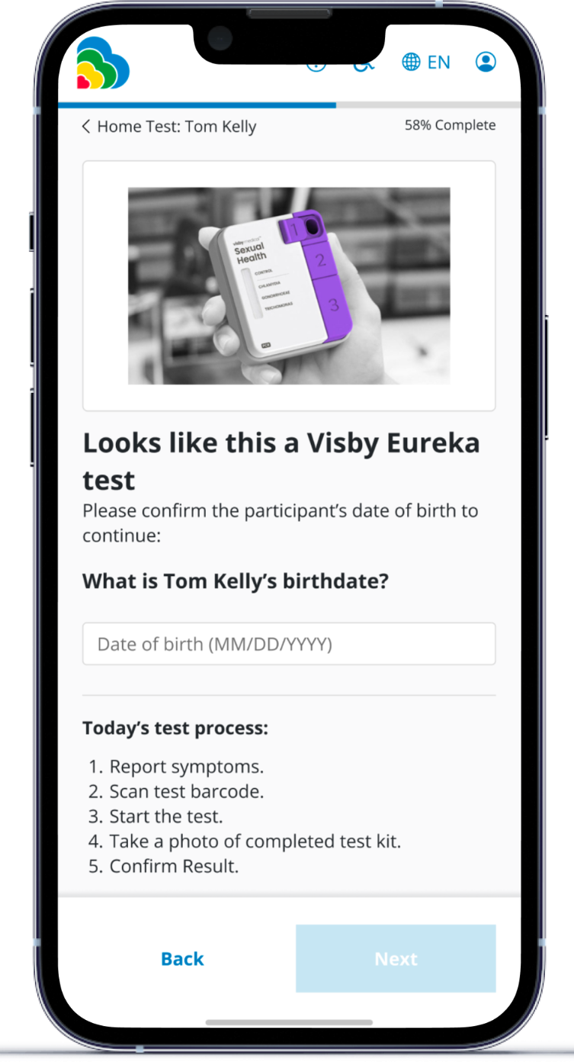
Guide the user through your test process
Scanning a barcode will pull up your device instructions and then send them into your device flow experience

Slide 29
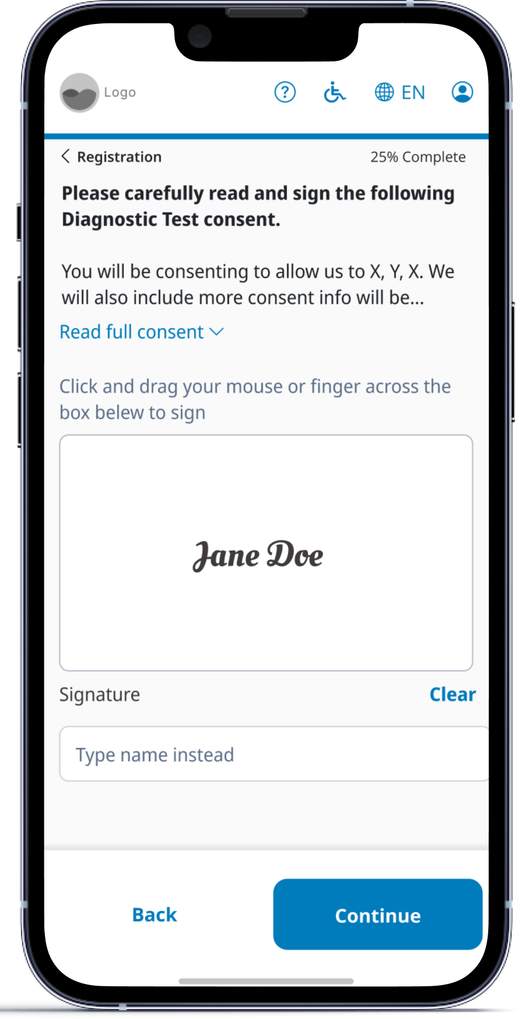
Collect patient info and consent
Support multilingual consents with digital signatures
Easy-to-manage versions across different devices
Add insurance cards to offset patient costs

Slide 30
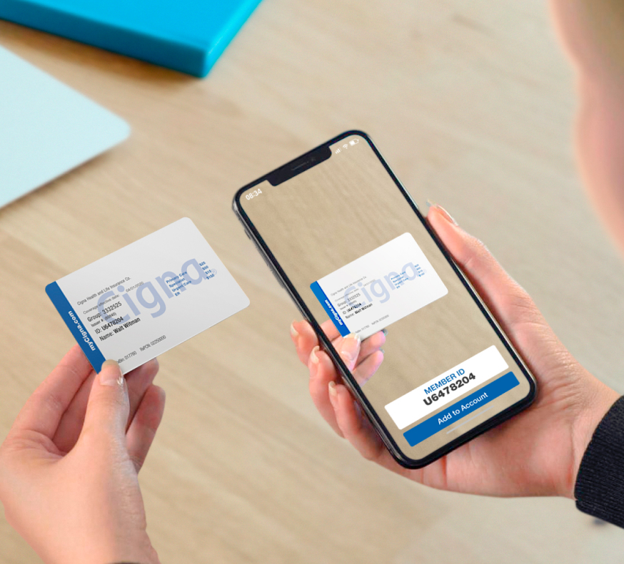
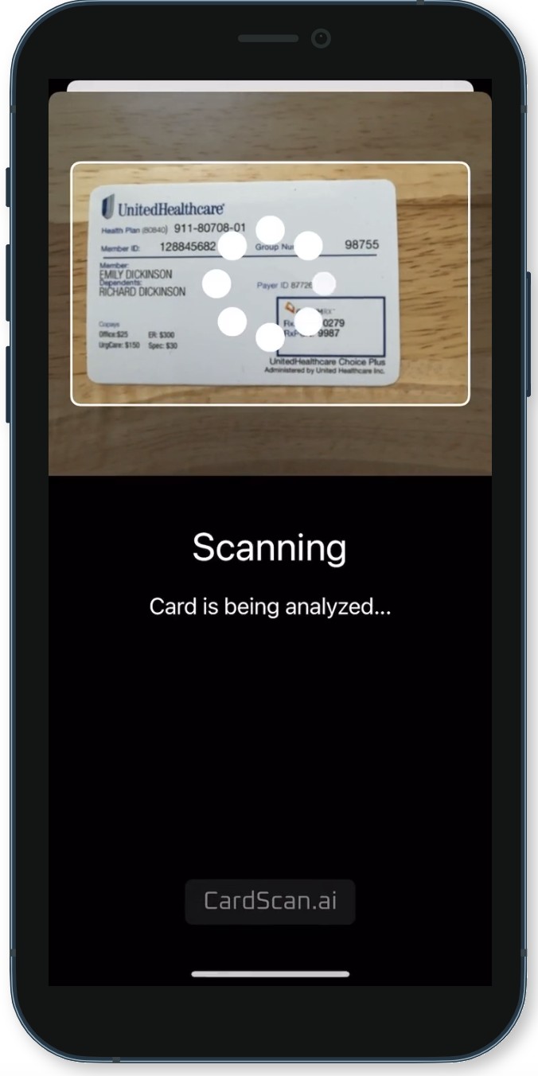
… and insurance
Insurance card scanner to reduce errors in entry

Slide 31
Machine learning minimizes user error
State of the art machine learning can read results from your device so patients and providers don’t have to
99.8% accuracy on multiple types of visual indicators
All images are saved for future reference Model runs over ~50k images/wk

Slide 32
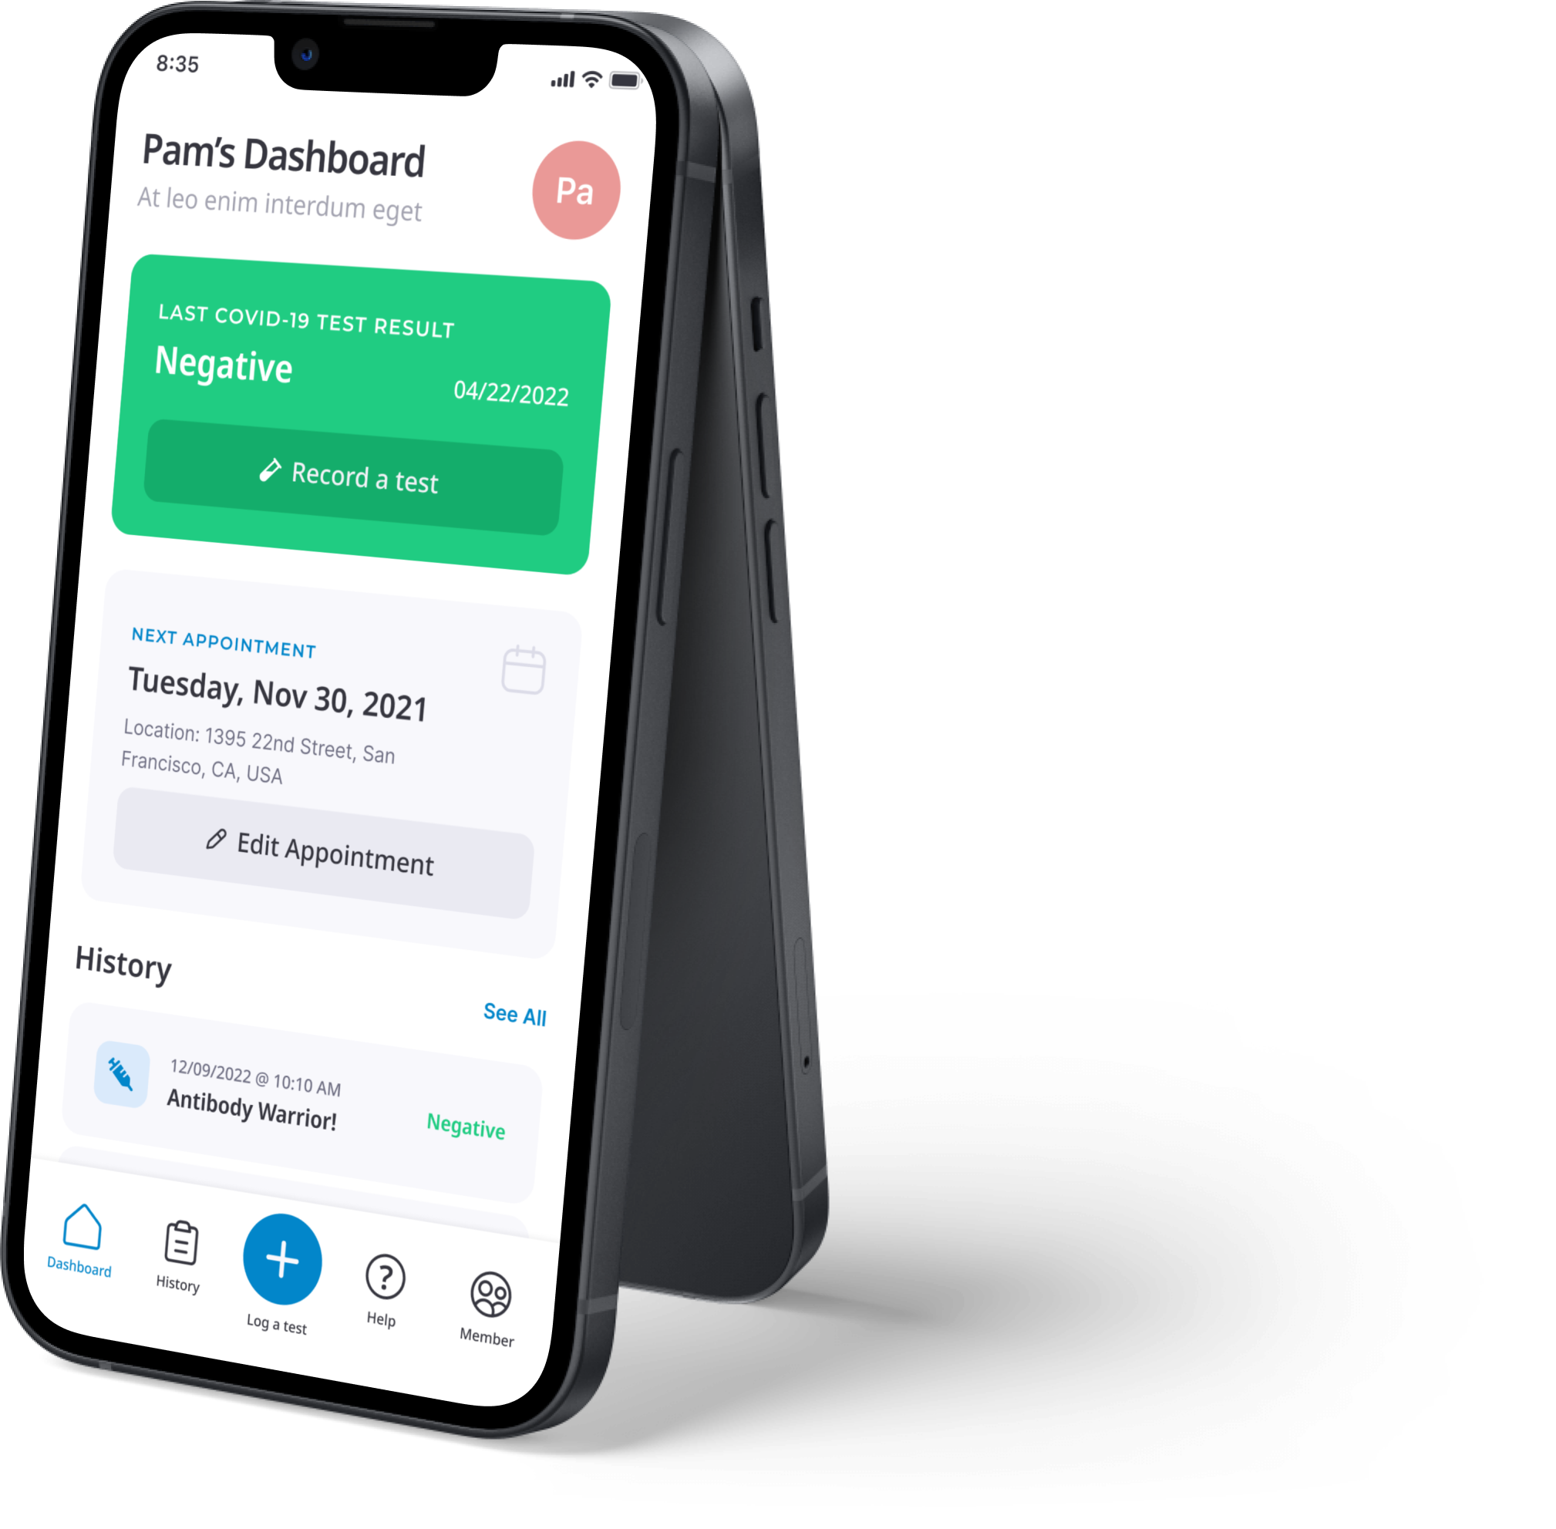
Actionable next steps for connecting to care
Test-to-treat with
clinicians available at
each step, on demand or by appointment
Patients send results to their own provider via SMART® on FHIR™ or HL7
Automatic public health result submission for reportable diseases

Slide 33
Thank you to the Primary.Health team & all our partners!

Slide 34
Come talk to us!
chris@primary.health

Slide 35
Primary Diagnostics, Inc.
595 Pacific Ave Floor 4
San Francisco, CA 94133
1-855-970-3223

